Slide 1
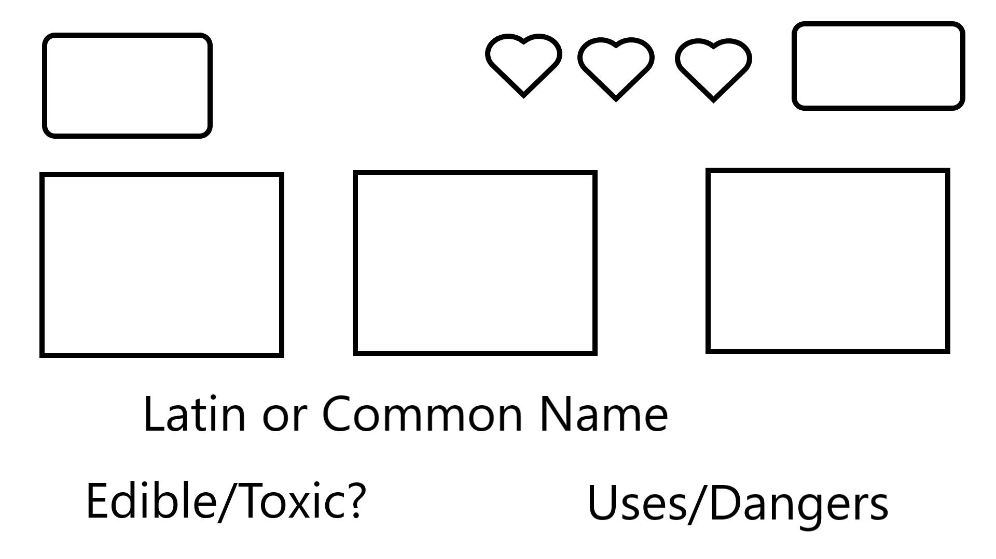
Points
Menu
Randomized Image 1
Randomized Image 2
Randomized Image 3

Slide 2
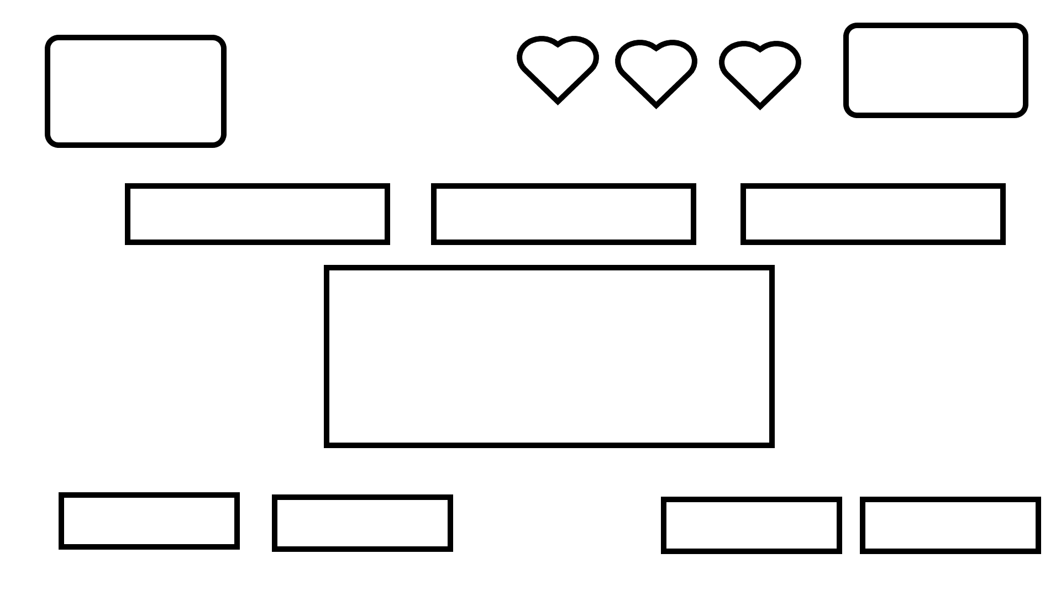
Points
Menu
Possible Latin/common name 1
Possible Latin/common name 2
Possible Latin/common name 3
Reference Image
Edible
Toxic
Uses (dropdown)
Dangers (dropdown)

